Slide 1
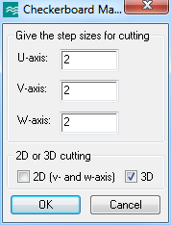
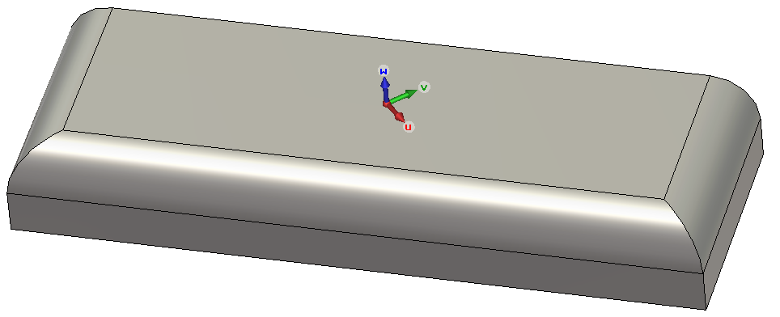
Cut Selected Objects into Checkerboard Pieces
Give the size of the pieces in each coordinate direction. If WCS is not active, global coordinates are used. Only 2D (slicing only in v- and w-directions) or 3D option can be active at the same time.

Slide 2
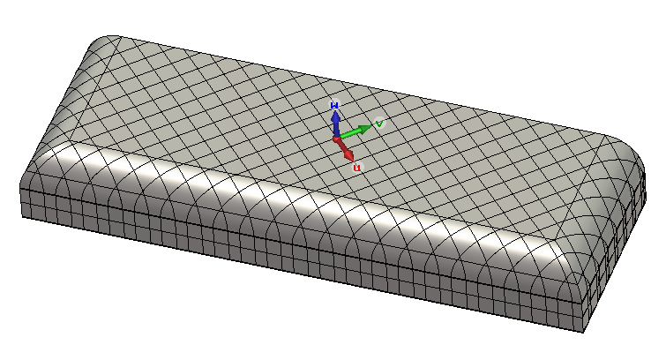
Cut Selected Objects into Checkerboard Pieces

